Slide 1

01
AI-POWERED COMMENT TRIAGE FOR EFFICIENT COLLABORATION AND FEEDBACK MANAGEMENT
Authors
Sravani Pati, Vamsi Krishna Pasam, Carlos Toxtli Hernandez
The 40th ACM/SIGAPP Symposium On Applied Computing
Human AI Empowerment Lab, Clemson University

Slide 2

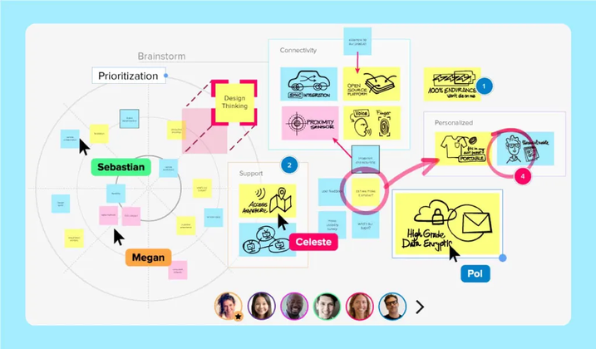
02
Introduction
Essential for virtual teamwork (Google Docs, Confluence).
Challenges: Increasing comment volume, difficult to manage manually.
Objective: Develop an automated AI-driven system to categorize and prioritize comments.

Slide 3




03
Problem Statement!
Can collaborative platforms keep pace with the scale and complexity of user feedback as comment threads become increasingly layered and dynamic?

Slide 4



04
Effectiveness of Hierarchical Capsule Networks vs. Transformer models.
Research Questions!
GEMMA-2B performance in Zero-shot vs. N-shot learning.
Role of LDA in enhancing thematic insights and triage accuracy.

Slide 5
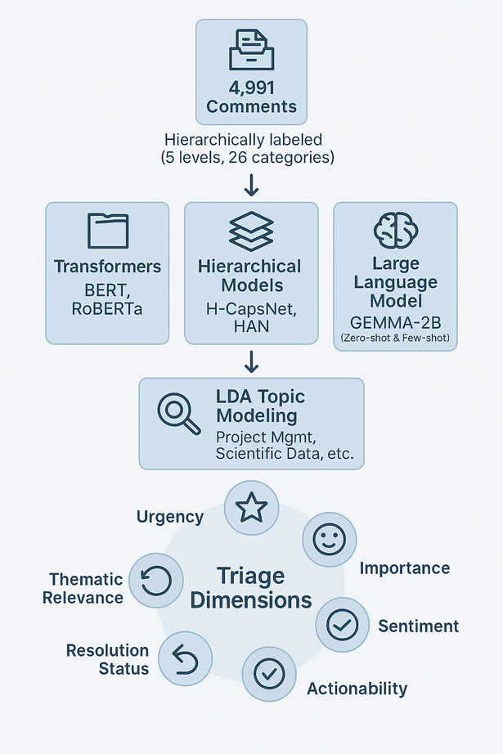
05
Methodology
Dataset
Curated 4,991 comment dataset with hierarchical labels.
Machine Learning Approaches
Transformer Models: BERT, RoBERTa
Hierarchical Models: H-CapsNet, HAN
Large Language Model: GEMMA-2B (zero-shot & few-shot learning)
Thematic Analysis: Latent Dirichlet Allocation (LDA)
Priority Dimensions: urgency, importance, sentiment, actionability, resolution status, thematic relevance.

Slide 6
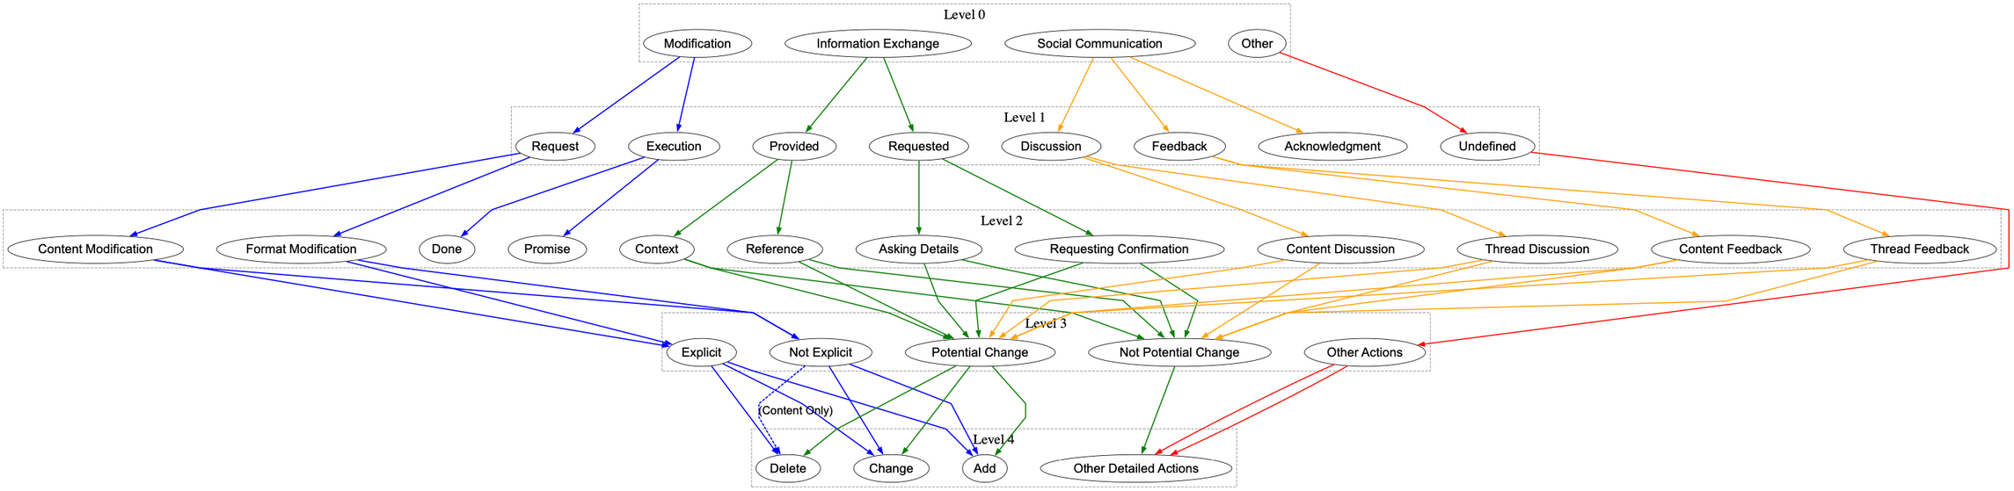
06
Hierarchical Taxonomy of Comments

Slide 7
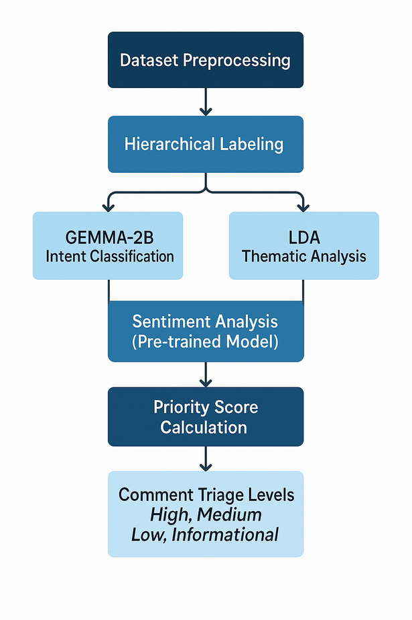
07
Work Summary
Development of Triage System
Custom rule-based system with integrated ML components (GEMMA-2B, Hugging Face, LDA).
Priority scoring mechanism and triage categorization.
Experimental Environment
High-performance computing (60 CPU cores, 120 GB RAM, 8 GPUs, SSD storage).

Slide 8
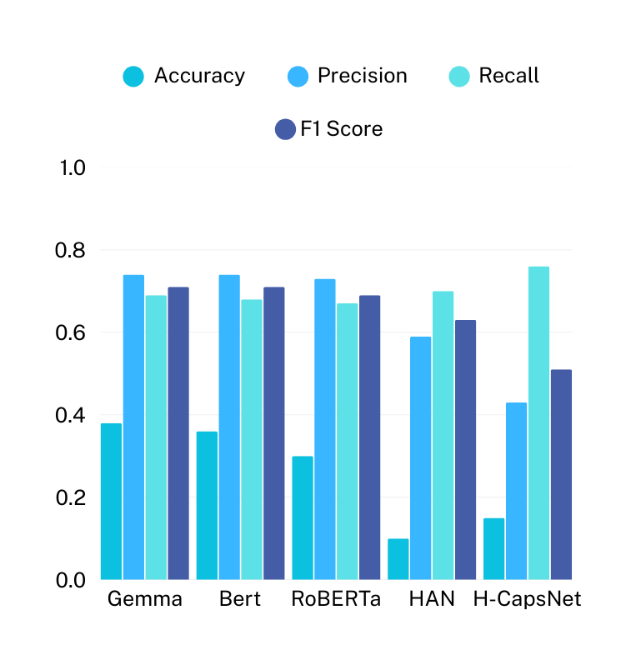
08
Results
Overall Model Comparison
GEMMA-2B: 0.7133 (highest performance in zero-shot and N-shot scenarios)
BERT & RoBERTa: Strong general performance across categories.
Hierarchical models (HAN, H-CapsNet): Lower performance in capturing broad contexts.
Back to Agenda Page

Slide 9
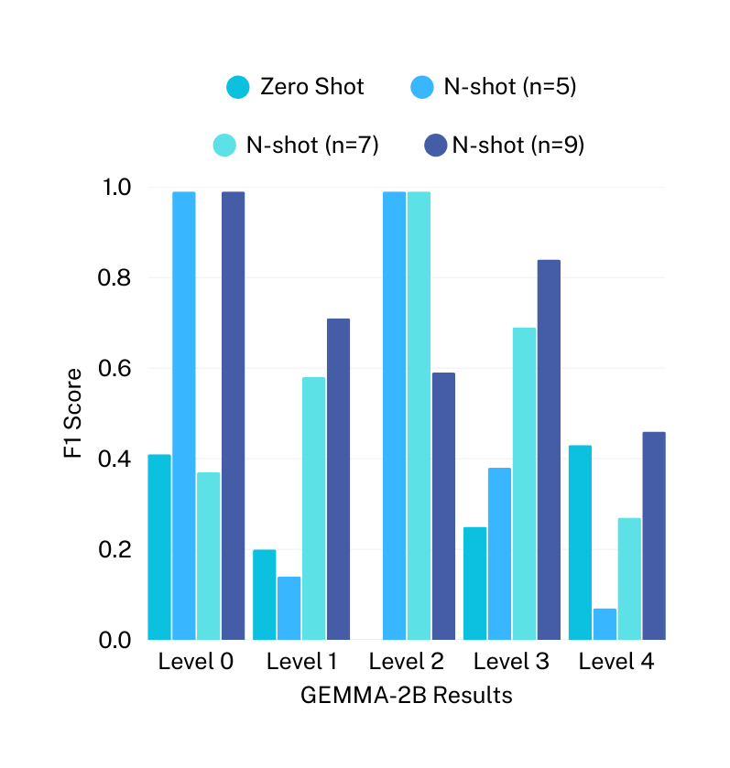
09
Results
Impact of Zero-shot vs N-shot Learning
Improvement observed with minimal data (5-shot), highest gains at 9-shot.
Back to Agenda Page

Slide 10
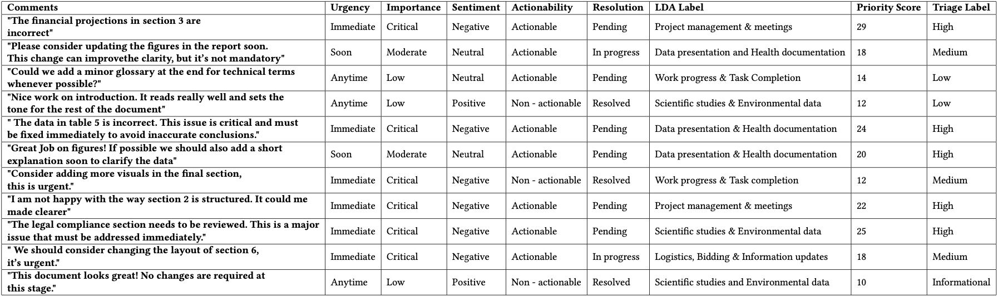
10
Triage System Test Cases (Expected Outcomes)

Slide 11
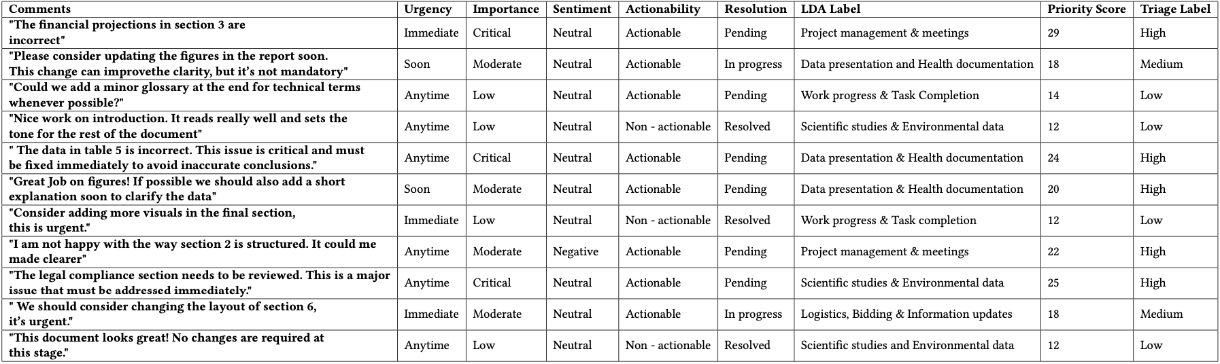
11
Triage System Predicted (System Outcomes)
Successfully prioritized comments based on urgency, importance, and actionability.

Slide 12
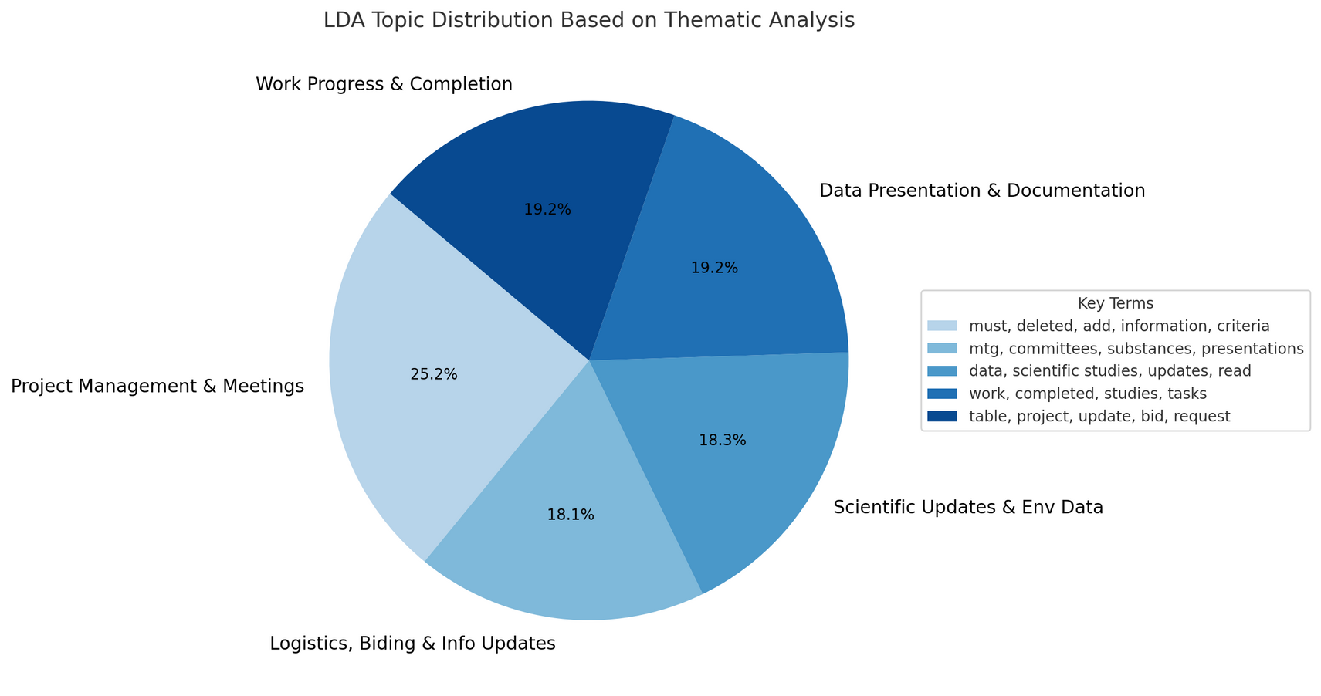
12
LDA-Based Thematic Analysis
Enhanced thematic context recognition, improving prioritization accuracy.

Slide 13



13
Conclusion!
Key Contributions
Effective automated comment triage system integrating ML and NLP techniques.
Demonstrated superiority of Transformer models and GEMMA-2B in comment classification tasks.

Slide 14
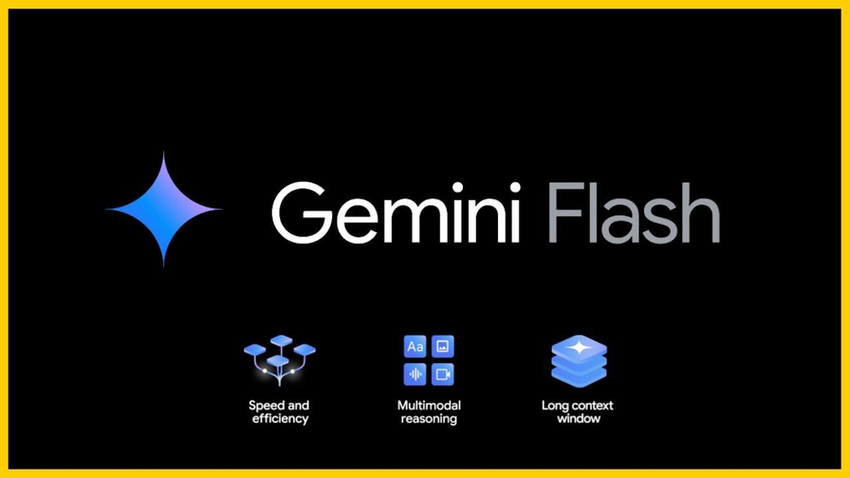
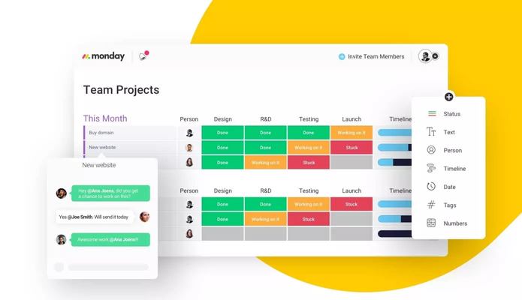
14
Limitations & Future Work
Limitations
Class imbalance and sentiment prediction accuracy.
Future Directions
Advanced model exploration (Gemini Pro 1.5, Gemini Flash).
Enhanced user interface integration and predictive automation.

Slide 15
15
Thank you!
<Any_Questions?>

